Slide 1
Functions and Variable Scope
Lecture 11

Slide 2
Function Abstraction
Function body : a black box
contains the detailed implementation for the Function.
Optional arguments
Optional return
for Input
value
Method Signature
Black Box
Method body

Slide 3
Why Use Functions?
Break the problem into smaller sub-problems
Makes solving complex problems easier.
Generalize a repeated set of instructions
No need to write the same code over and over.
printf and scanf are good examples.
Make the program easier to read and maintain.

Slide 4
Function Definition
prototype
return-type name(parameter-list)
{ local-variables
statements
return statement }
return-type: int, double, char, void, ...
parameter-list: type name, type name, ..., type name
Function variables = parameters + locals

Slide 5
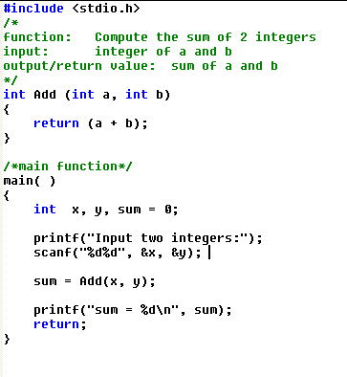
parameter list
define
call
arguments

Slide 6
Stack
x
y
sum
a
b
main
Add

Slide 7
Return Statement
The return statement:
Terminates the execution of the function.
Returns a value to the calling function.
The type of the value returned must be the same as the return-type of the function.

Slide 8
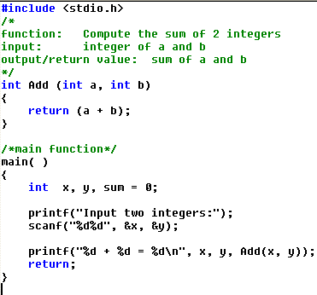

Slide 9
Function: call by value
Function arguments are passed by copying their values.
A change to the value of an argument in a function body will not change the value of variables in the calling function.

Slide 10
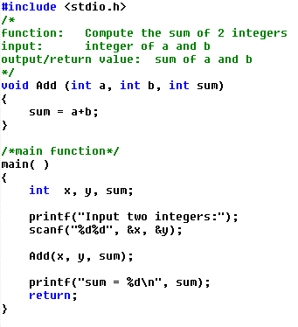

Slide 11
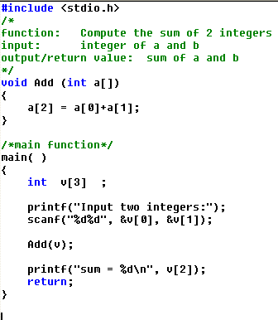

Slide 12
power p25
#include <stdio.h>
int power(int m, int n);
int main()
{
int i;
for (i = 0; i < 10; ++i)
printf("%d %d %d\n", i, power(2,i), power(-3,i));
return 0;
}
int power(int base, int n)
{
int i, p;
p = 1;
for (i = 1; i <= n; ++i)
p = p * base;
return p;
}

Slide 13
atoi p43
#include <stdio.h>
int atoi(char s[]);
int main()
{
char str[100];
gets(str);
printf("%d\n", atoi(str));
return 0;
}
int atoi(char s[])
{
int i,n;
n=0;
for(i=0;s[i]>='0'&&s[i]<='9';++i)
n=10*n+(s[i]-'0');
return n;
}

