Slide 1
Functions and Variable Scope
Lecture 11

Slide 2
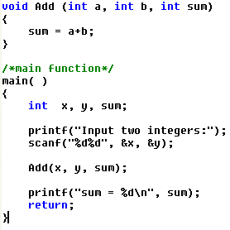
Scope rules: p80
Automatic variables
local variables: within { }
function parameters: within( )

Slide 3
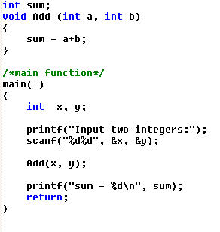
Scope rules: p80
External variables
outside all functions

Slide 4
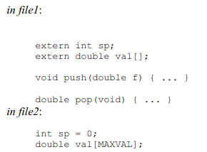
External variables in multiple files

Slide 5
Lifetime
Stack
Automatic variable
as long as the function containing it
begin with call
end with return
External variable
as long as the whole program
begin before program start (call main)
end with program exit
DataSegment

Slide 6
Default Initialization
Automatic variable: Stack
If NO explicit initialization
Random value
External variable: Datasegment
If NO explicit initialization
ZERO

Slide 7
Static Variables
Outside all functions
scope: external but only within the file
lifetime: as long as the program
Within any functions
scope: local
lifetime: but as long as the program

Slide 8
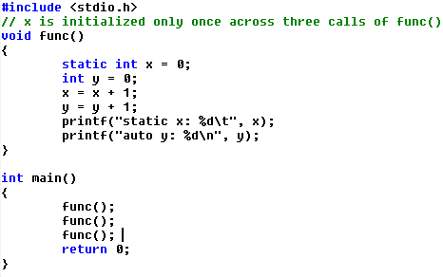

Slide 9
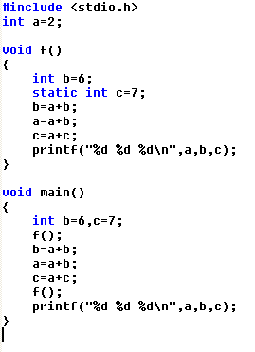
10 8 17
58 32 75
58 16 33
Notes:
10 8 17
58 32 75
58 16 33
Press any key to continue

