Slide 1
Pointers and Arrays
Lecture 13

Slide 2
5.1 Pointers and Addresses
Variables in Memory
The compiler determines where variables are placed in memory
This placement cannot be changed by programmers
int n; char c; double x;
1004
1000
1003
1005
1012
n
c
x

Slide 3
Operators for pointers p94
How to define a pointer?
The operator * in declaration
How to assign a pointer?
The operator & gives the address of the variable in memory
1000
1004
1008
1044
1048
x
y
z
ip
Notes:
The &operator only
applies to objects in memory: variables and array elements. It cannot be applied to
expressions, constants, or registervariables.

Slide 4
Operators for pointers
How to use a pointer?
The operator * : indirection operator
间接引用运算符
Another way of pointer assignment
Notes:
int *ip;
is intended as a mnemonic; it says that the expression *ipis an int

Slide 5
x and *ip
equal to x = x+10;
equal to y = x+1;

Slide 6
Summary
Pointers
Declaration
Assignment
Reference

Slide 7
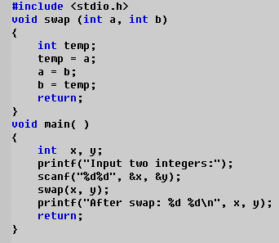
5.2 Pointers and function arguments p95
classical function: swap

Slide 8
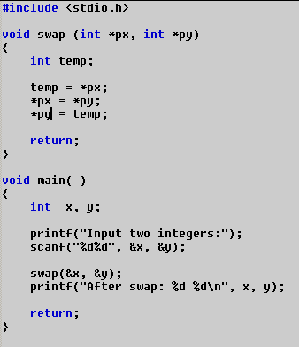
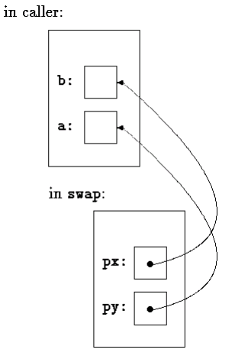

Slide 9
P27-28
Modify a variable in a calling routine, the caller must provide the address!
The array elements cannot be copied and passed!

Slide 10
5.3 Pointers and Arrays
Twins: pointers and arrays
a block of ten consecutive objects named a[0],a[1],…,a[9]
int a[10];
1000
1004
1008
1032
1036
The name of an array is a synonym for the location of the initial element! p99
a[0]
a[1]
a[2]
a[8]
a[9]
a == &a[0]
the array a

Slide 11
Pointers and Arrays
equal to
1000
1004
1008
1032
1036
a[0]
a[1]
a[2]
a[8]
a[9]
the array a

Slide 12
pa = a; pa+1? pa+2?
1000
1004
1008
1032
1036
a[0]
a[1]
a[2]
a[8]
a[9]
the array a
pa+1 == &a[1]
pa+2 == &a[2]

Slide 13
Note1
operator * and ++
the same precedence
associate from right to left
++*pa; *pa++; *++pa;

Slide 14
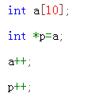
Note2
An array name is not a variable, so cannot be incremented.
×
√

Slide 15
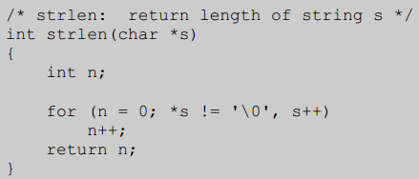
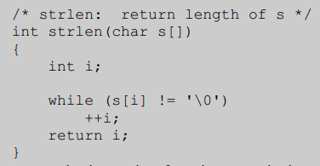
How about in parameters?
As function parameters,
No difference!

Slide 16
binary search
int binsearch(int x, int v[], int n);
int main( )
{
int v[15]={3,7,12,14,19,20,26,28,30,35,37,39,40,41,45};
int a, index;
scanf("%d", &a);
index = binsearch( a, v, 15 );
if( index >= 0)
printf("%d is found at index %d\n", a, index);
else
printf("%d is not found\n", a);
return 0;
}

Slide 17
期末考试题型
一、判断题 4题 *1分
二、小填空 9题 *2分
三、程序阅读 7题*4分
四、程序填空 15空*2分
五、编程题 2题*10分

