Slide 1
Operators & Expressions
Lecture 2

Slide 2
What to learn
Some basic definitions
More data types
int char
float double
Deeper into ASCII
New operators
+ - * /
% && || ! ++ -- += etc…
Type conversion

Slide 3
What to learn
Some basic definitions
More data types
Deeper into ASCII
New operators
Type conversion

Slide 4
Some definitions (ExB 2-1.2)
Variables & Constants
Operators
Expressions
Types
Name of variables

Slide 5
1. Variables & Constants
Variables and constants
the basic data objects manipulated in a program
Declarations
list the variables to be used
state what type they have
perhaps state what their initial values are
All variables must be declared before they are used.

Slide 6
Constants (p37)
Integer constant
1234
Character constant
one character within single quotes
‘A’
the value in ASCII chart
65

Slide 7
Variable initialization
With any constant expressions of proper type
With other variables or expressions

Slide 8
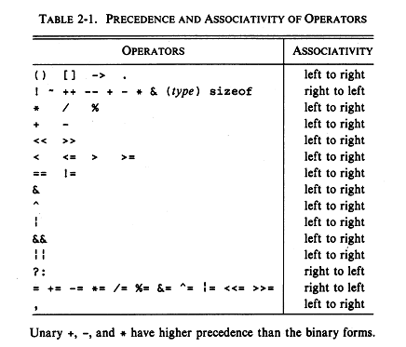
2. Operators
specify what is to be done to variables and constants.
Unary Operators

Slide 9
3. Expressions
combine variables and constants to produce new values.
consists of variables/constants, operators, functions.
Example

Slide 10
4. Type
Determines variables:
the set of values it can have
what operations can be performed on it
Example
int: cannot be floats
% ++ -- : only accept integers

Slide 11
5. Name of variables
Names are made up of letters and digits
the first character must be a letter
The underscore '_' counts as a letter
Upper and lower case letters are distinct
x and X are two different names.

Slide 12
What to learn
Some basic definitions
More data types
Deeper into ASCII
New operators
Type conversion

Slide 13
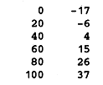
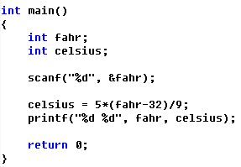
More data types
More precision?
single floating-point number

Slide 14
What we need
 | integers | characters | Single floating point number
Type | int a; | char c;
Read | scanf(“%d”,&a); | scanf(“%c”,&c);
Print | printf(“%d”,a); | printf(“%c”,c);

Slide 15
What we need
 | integers | characters | Single floating point number
Type | int a; | char c; | float v;
Read | scanf(“%d”,&a); | scanf(“%c”,&c); | scanf(“%f”,&v);
Print | printf(“%d”,a); | printf(“%c”,c); | printf(“%f”,v);

Slide 16
Data types (p36)
Basic data types

Slide 17
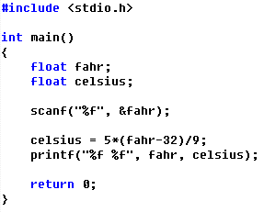
Fahrenheit to Celsius
Single floating-point version

Slide 18
Too many digits after the decimal point?
More about %f
format the number to two digits after the decimal point
%.2f

Slide 19
Review
1. ASCII Code
2. Basic Definition
Variables & Constants
Operators
Expressions
Name of variables
3. Types
int char float

Slide 20
What to learn
Some basic definitions
More data types
Deeper into ASCII
New operators
Type conversion

Slide 21
How ASCII code stored in memory?
Value, not figure

Slide 22
Groups of Ascii code
Digits
‘0’-’9’
Upper-case letters
‘A’-’Z’
Lower-case letters
‘a’-’z’

Slide 23
What to learn
Some basic definitions
More data types
Deeper into ASCII
New operators
Type conversion

Slide 24
Arithmetic Operators p41
+ - * / %
The special one: %
produce the remainder:
cannot be applied to float numbers
Notes:
28

Slide 25
Arithmetic Operators p41
Precedence
Higher: * / %
Lower: + -
Association
Left to Right

Slide 26
Relational operators p41
Result: 0 or 1
Notes:
0 1
1

Slide 27
Relational operators p41
Precedence
Higher: > >= < <=
Lower: == !=
Lower than arithmetic operators
Association
Left to Right
Notes:
1

Slide 28
Logical operators p41
Result: 0 or 1
 | Zero | Non-zero
！expr

Slide 29
Logical operators p41
Result: 0 or 1
 | Zero | Non-zero
！expr | 1 | 0

Slide 30
Logical operators p41
Result: 0 or 1
expr1&&expr2 | Zero | Non-zero
Zero
Non-zero
expr1||expr2 | Zero | Non-zero
0
Non-zero

Slide 31
Logical operators p41
Result: 0 or 1
expr1&&expr2 | Zero | Non-zero
Zero | 0 | 0
Non-zero | 0 | 1
expr1||expr2 | Zero | Non-zero
0
Non-zero

Slide 32
Logical operators p41
Result: 0 or 1
expr1&&expr2 | Zero | Non-zero
Zero | 0 | 0
Non-zero | 0 | 1
expr1||expr2 | Zero | Non-zero
0 | 0 | 1
Non-zero | 1 | 1

Slide 33
Logical operators p41

Slide 34
Logical operators p41
Precedence
Higher: &&
Lower: ||
Lower than relative operators
Association
Left to Right
Notes:
1

Slide 35
Logical operators
How to express “ 0<x<10” ?

Slide 36
Increment and Decrement p46
++ --
prefix: ++n, --n
postfix: n++,n--
Note: if n=5
x = n++; ??
x = ++n; ??
(i+j)++ is illegal!!

Slide 37
Assignment operators p50
i = i + 2; -> i += 2;
x *= y+1; ??
correspond better to the way people think

Slide 38
Assignment operators p50
Precedence
The second lowest operators
Association
Right to Left
int i;
float f;
f = i = 33.3f;

Slide 39
What to learn
Some basic definitions
More data types
Deeper into ASCII
New operators
Type conversion

Slide 40
Type conversion （automatic）
An operator has operands of different types
narrower -> wider
automatically
have to make sense
1.1%2 not allowed
warning: assign “wider” to “narrower”
int a = 1.1;
char is a small integer

Slide 41
Type conversion （explicitly）
have to make sense
1.1%2 not allowed
warning: assign “wider” to “narrower”
int a = 1.1;
1.1%2 -> (int)1.1%2
int a = 1.1 -> int a=(int)1.1

Slide 42
Conversion rules
Lower is promoted to higher (p44)
How implemented p45
Drop bits
int -> char
float -> int

Slide 43
Review
The structure of a C program
main
int main(void)
{
declarations
statements
}
#include
printf
scanf

Slide 44
Review
Expressions
operators
precedence and association
variables
name rules
type
declaration
constants
type

Slide 45
END

Slide 46
Review
ASCII code
digits
‘0’-’9’
upper-case letters
‘A’-’Z’
lower-case letters
‘a’-’z’
controls
‘\n’, ‘\t’

Slide 47
Comments
A comment begins with /* and end with */.
/* This is a comment */
Comments may appear almost anywhere in a program, either on separate lines or on the same lines as other program text.

Slide 48
celsius.c
/* Converts a Fahrenheit temperature to Celsius */
#include <stdio.h>
#define FREEZING_PT 32.0f
#define SCALE_FACTOR (5.0f / 9.0f)
int main(void)
{
float fahrenheit, celsius;
printf("Enter Fahrenheit temperature: ");
scanf("%f", &fahrenheit);
celsius = (fahrenheit - FREEZING_PT) * SCALE_FACTOR;
printf("Celsius equivalent: %.1f\n", celsius);
return 0;
}

Slide 49
Layout of a C Program
The amount of space between tokens usually isn’t critical.
Tokens
Identifiers
Keywords
Operators
Punctuation
Constants
String literals

Slide 50
Layout of a C Program
In fact, adding spaces and blank lines to a program can make it easier to read and understand.
Indentation(缩进) can make nesting easier to spot.
Blank lines(空行) can divide a program into logical units.

Slide 51
Review of Exercises
A1
2: 3
A2
2： 3，5，6，7
3： 4

Slide 52
upc.c
/* Computes a Universal Product Code check digit */
#include <stdio.h>
int main(void)
{
int d, i1, i2, i3, i4, i5, j1, j2, j3, j4, j5,
first_sum, second_sum, total;
printf("Enter the first (single) digit: ");
scanf("%1d", &d);
printf("Enter first group of five digits: ");
scanf("%1d%1d%1d%1d%1d", &i1, &i2, &i3, &i4, &i5);
printf("Enter second group of five digits: ");
scanf("%1d%1d%1d%1d%1d", &j1, &j2, &j3, &j4, &j5);
first_sum = d + i2 + i4 + j1 + j3 + j5;
second_sum = i1 + i3 + i5 + j2 + j4;
total = 3 * first_sum + second_sum;
printf("Check digit: %d\n", 9 - ((total - 1) % 10));
return 0;
}

Slide 53
