Slide 1
Control Flow- Conditional Control
Lecture 4

Slide 2
3.1 Statements and Blocks
Statement
An expression followed by a semicolon.
Compound statement or block
declarations and statements grouped by braces {}
syntactically equal to a single statement
NO SEMICOLON after the right brace.
Notes:
讲课+题目解释

Slide 3
Types of statements
Most of C’s remaining statements fall into three categories:
Selection statements: if and switch
Iteration statements: while, do, and for
Jump statements: break, continue, and goto. (return also belongs in this category.)

Slide 4
Selection Statements
The if statement
The else clause
Cascaded if statements
Conditional expression
The switch statement

Slide 5
Selection Statements
The if statement
The else clause
Cascaded if statements
Conditional expression
The switch statement

Slide 6
if statement
Allows a program to choose between two alternatives by testing an expression.
The simplest form
if(expression) statement

Slide 7
if statement
N
n>0
忽略
Y
printf
positive

Slide 8
if(expression) statement
single statement
compound statement
Notes:
程序运行

Slide 9
Compare two cases

Slide 10
else clause
N
printf
non-positive
n>0
Y
printf
positive

Slide 11
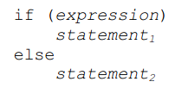
if-else p55
tests the numeric value of an expression
else part is optional

Slide 12
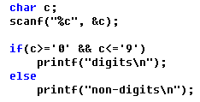
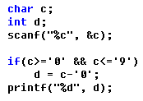
Determination of digit p43

Slide 13
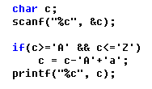
Convert upper to lower p43

Slide 14
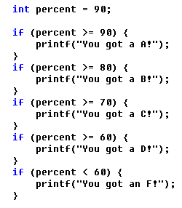
Program reading

Slide 15
Selection Statements
The if statement
The else clause
Cascaded if statements
Conditional expressions
The switch statement

Slide 16
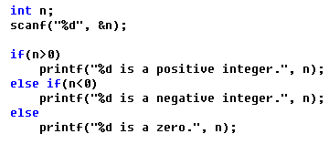
Cascaded if statements
Allows a program to choose between more than n alternatives by testing n-1 expression.

Slide 17
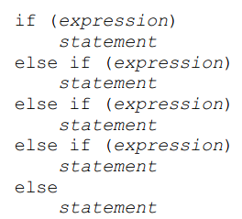
Else-if: multi-way decision p57
none of the above

Slide 18
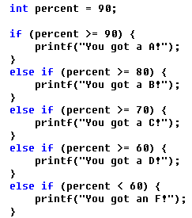
Program reading

Slide 19
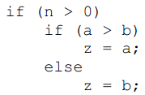
Example-1 on p56
N
n>0
忽略
Y
N
a>b
z=b
Y
z=a

Slide 20
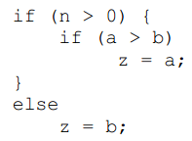
Example-2 on p56
N
n>0
z=b
Y
N
a>b
忽略
Y
z=a

Slide 21
Selection Statements
The if statement
The else clause
Cascaded if Statements
Conditional Expressions
The switch statement

Slide 22
Conditional Expressions p51

Slide 23
Review
Statement
Single statement
Compound statement
Selection statement
The if statement
The else clause
Cascaded if Statements
Multi-way selection
Conditional Expressions

Slide 24
Selection Statements
The if statement
The else clause
Cascaded if Statements
Conditional Expressions
The switch statement

Slide 25
3.4 switch: multi-way decision p58
a group of statements!
constant expression!

Slide 26
switch statement
switch (grade) {
case 4: printf("Excellent");
break;
case 3: printf("Good");
break;
case 2: printf("Average");
break;
case 1: printf("Poor");
break;
case 0: printf("Failing");
break;
default: printf("Illegal grade");
break;
}
Notes:
运行程序

Slide 27
switch statement
switch (grade) {
case 4:
case 3:
case 2:
case 1: printf("Passing");
break;
case 0: printf("Failing");
break;
default: printf("Illegal grade");
break;
}

Slide 28
switch statement
switch (grade) {
case 4: printf("Excellent");
case 3: printf("Good");
case 2: printf("Average");
case 1: printf("Poor");
case 0: printf("Failing");
default: printf("Illegal grade");
}

