Slide 1
Control Flow- Conditional Control
Lecture 7

Slide 2
Selection Statements
The if statement
The else clause
Cascaded if Statements
Conditional Expressions
The switch statement

Slide 3
3.4 switch: multi-way decision p58
a group of statements!
constant expression!

Slide 4
switch statement
switch (grade) {
case 4: printf("Excellent");
break;
case 3: printf("Good");
break;
case 2: printf("Average");
break;
case 1: printf("Poor");
break;
case 0: printf("Failing");
break;
default: printf("Illegal grade");
break;
}
Notes:
运行程序

Slide 5
switch statement
switch (grade) {
case 4:
case 3:
case 2:
case 1: printf("Passing");
break;
case 0: printf("Failing");
break;
default: printf("Illegal grade");
break;
}

Slide 6
switch statement
switch (grade) {
case 4: printf("Excellent");
case 3: printf("Good");
case 2: printf("Average");
case 1: printf("Poor");
case 0: printf("Failing");
default: printf("Illegal grade");
}

Slide 7
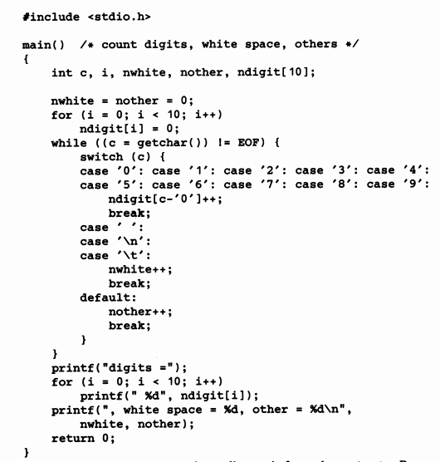
p59

