Slide 1
Flow Control : Loop
Lecture 5

Slide 2
Iteration statements
while statement
for statement
do statement

Slide 3
Iteration statements
while statement
for statement
do statement

Slide 4
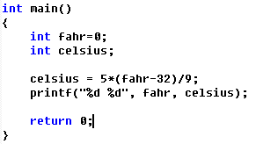
Fahrenheit to Celsius
A single temperature

Slide 5
Fahrenheit to Celsius
How about many temperatures?
0
10
20
30
40
50
60
70
80
90
100

Slide 6
int fahr;
int celsius;
fahr = 0;
celsius = 5*(fahr-32)/9;
printf("%d %d", fahr, celsius);
fahr = 10;
celsius = 5*(fahr-32)/9;
printf("%d %d", fahr, celsius);
fahr = 20;
celsius = 5*(fahr-32)/9;
printf("%d %d", fahr, celsius);
fahr = 30;
celsius = 5*(fahr-32)/9;
printf("%d %d", fahr, celsius);
fahr = 40;
celsius = 5*(fahr-32)/9;
printf("%d %d", fahr, celsius);
fahr = 50;
celsius = 5*(fahr-32)/9;
printf("%d %d", fahr, celsius);
fahr = 60;
celsius = 5*(fahr-32)/9;
printf("%d %d", fahr, celsius);
fahr = 70;
celsius = 5*(fahr-32)/9;
printf("%d %d", fahr, celsius);
fahr = 80;
celsius = 5*(fahr-32)/9;
printf("%d %d", fahr, celsius);
fahr = 90;
celsius = 5*(fahr-32)/9;
printf("%d %d", fahr, celsius);
fahr = 100;
celsius = 5*(fahr-32)/9;
printf("%d %d", fahr, celsius);

Slide 7
int fahr;
int celsius;
fahr = 0;
celsius = 5*(fahr-32)/9;
printf("%d %d", fahr, celsius);
fahr = 10;
celsius = 5*(fahr-32)/9;
printf("%d %d", fahr, celsius);
fahr = 20;
celsius = 5*(fahr-32)/9;
printf("%d %d", fahr, celsius);
fahr = 30;
celsius = 5*(fahr-32)/9;
printf("%d %d", fahr, celsius);
fahr = 40;
celsius = 5*(fahr-32)/9;
printf("%d %d", fahr, celsius);
fahr = 50;
celsius = 5*(fahr-32)/9;
printf("%d %d", fahr, celsius);
fahr = 60;
celsius = 5*(fahr-32)/9;
printf("%d %d", fahr, celsius);
fahr = 70;
celsius = 5*(fahr-32)/9;
printf("%d %d", fahr, celsius);
fahr = 80;
celsius = 5*(fahr-32)/9;
printf("%d %d", fahr, celsius);
fahr = 90;
celsius = 5*(fahr-32)/9;
printf("%d %d", fahr, celsius);
fahr = 100;
celsius = 5*(fahr-32)/9;
printf("%d %d", fahr, celsius);
00
fahr+100
fahr+100
fahr+100
fahr+100
fahr+100

Slide 8
Repeat
What to repeat
celsius = 5*(fahr-32)/9;
printf("%d %d", fahr, celsius);
fahr = fahr+10;
When to begin
fhar = 0
When to stop
fhar > 100

Slide 9
while statement p60
while(expression) statement
expression:
non-0 to continue
0 to stop
if(expression) statement

Slide 10
if statement: flowchart
N
farh<=100
Y
celsisu = …;
printf(…);
farh += 10;
other statements
Notes:
Be careful: endless loop

Slide 11
while statement: flowchart
N
farh<=100
Y
celsisu = …;
printf(…);
farh += 10;
other statements
Notes:
Be careful: endless loop

Slide 12
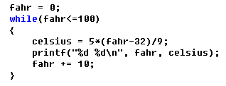
while statement

Slide 13
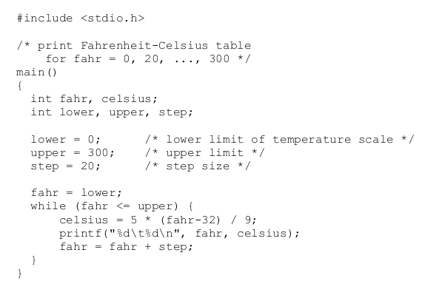
p9: Fahr-Cels Table V1
Notes:
和hello world类同的地方

Slide 14
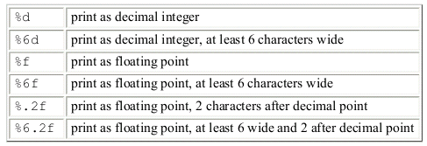
p12: Fahr-Cels Table V2
More accurate results

Slide 15
Iteration statements
while statement
for statement
do statement

Slide 16
for statement p60
for(expr1;expr2;expr3) statement
expr1
an initialization step
performed only once, before the loop begins to execute
epxr2
controls loop: non-0 to continue; 0 to stop.
epxr3
an operation
performed at the end of each loop iteration

Slide 17
for statement & while statement
for(expr1;expr2;expr3) statement
expr1;
while(expr2){
statement
expr3;
}

Slide 18
while statement to for statement
expr1;
while(expr2){ statement
expr3;
}
for(expr1;expr2;expr3) statement
Notes:
the choice between while and for is arbitrary: based on which is clearer!

Slide 19
p13: Fahr-Cels Table V3
never bury “magic numbers” in a program
not easy to read
not easy to change systematically
#define name replacement-text
Notes:
———

Slide 20
Symbolic constants p14

Slide 21
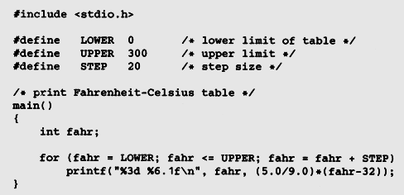
p15: Fahr-Cels Table V4

Slide 22
Process Characters
Chapter1 - 1.5

Slide 23
1.5 Character Input and Output
How to process character data
support from standard library
Text stream
a sequence of characters (p15)
-> lines(end with ‘\n’)
-> words(end with ‘\t’,‘ ’, ‘\n’)
-> other characters(ASCII)

Slide 24
How to read and write one character
Using standard library
read
write
reads the next input character from a text stream
prints the contents of the integer variable c as a character

Slide 25
1.5 Character Input and Output
1. File Copying
2. Character Counting
3. Line Counting
4. Word Counting

Slide 26
1.5.1 file copying
What is “end of file” indicator?
“character” stores in a variable
“is not”
!=

Slide 27
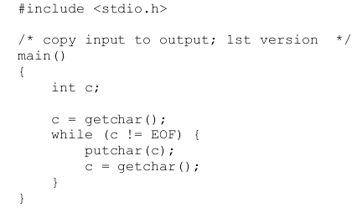
1.5.1 file copying p16
EOF:“end of file”
- defined in <stdio.h>
- \n + <ctrl+Z>
-<ctrl+Z>+<ctrl+Z>
Notes:
语句展开成顺序的

Slide 28
while( (c=getchar()) != EOF )
putchar(c);
printf("EOF: %d\n", c);

Slide 29
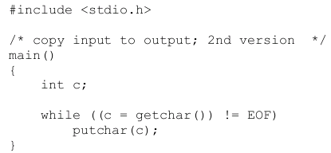
Version2: more concise p17
Relational operator: !=
c = getchar() != EOF is equivalent to c = (getchar() != EOF)
Notes:
getchar 由宏实现：#define getchar() getc(stdin）。getchar有一个int型的返回值.当程序调用getchar时.程序就等着用户按键.用户输入的字符被存放在键盘缓冲区中.直到用户按回车为止（回车字符也放在缓冲区中）.当用户键入回车之后，getchar才开始从stdin流中每次读入一个字符.getchar函数的返回值是用户输入的第一个字符的ASCⅡ码，如出错返回-1，且将用户输入的字符回显到屏幕.如用户在按回车之前输入了不止一个字符，其他字符会保留在键盘缓存区中，等待后续getchar调用读取.也就是说，后续的getchar调用不会等待用户按键，而直接读取缓冲区中的字符，直到缓冲区中的字符读完为后，才等待用户按键.
getch与getchar基本功能相同，差别是getch直接从键盘获取键值，不等待用户按回车，只要用户按一个键，getch就立刻返回，getch返回值是用户输入的ASCⅡ码，出错返回-1.输入的字符不会回显在屏幕上.getch函数常用于程序调试中，在调试时，在关键位置显示有关的结果以待查看，然后用getch函数暂停程序运行，当按任意键后程序继续运行.

