Slide 1
Process Characters
Lecture 6: Chapter1 - 1.5

Slide 2
1.5 Character Input and Output
Text stream
a sequence of characters (p15)
-> lines(end with ‘\n’)
-> words(end with ‘\t’,‘ ’, ‘\n’)
-> other characters(ASCII)

Slide 3
1.5 Character Input and Output
1. File Copying
2. Character Counting
3. Line Counting
4. Word Counting

Slide 4
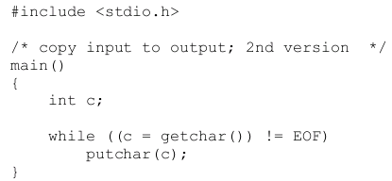
Version2: more concise p17
Notes:
getchar 由宏实现：#define getchar() getc(stdin）。getchar有一个int型的返回值.当程序调用getchar时.程序就等着用户按键.用户输入的字符被存放在键盘缓冲区中.直到用户按回车为止（回车字符也放在缓冲区中）.当用户键入回车之后，getchar才开始从stdin流中每次读入一个字符.getchar函数的返回值是用户输入的第一个字符的ASCⅡ码，如出错返回-1，且将用户输入的字符回显到屏幕.如用户在按回车之前输入了不止一个字符，其他字符会保留在键盘缓存区中，等待后续getchar调用读取.也就是说，后续的getchar调用不会等待用户按键，而直接读取缓冲区中的字符，直到缓冲区中的字符读完为后，才等待用户按键.
getch与getchar基本功能相同，差别是getch直接从键盘获取键值，不等待用户按回车，只要用户按一个键，getch就立刻返回，getch返回值是用户输入的ASCⅡ码，出错返回-1.输入的字符不会回显在屏幕上.getch函数常用于程序调试中，在调试时，在关键位置显示有关的结果以待查看，然后用getch函数暂停程序运行，当按任意键后程序继续运行.

Slide 5
1.5 Character Input and Output
1. File Copying
2. Character Counting
3. Line Counting
4. Word Counting

Slide 6
How to count characters?
Rewrite from “copying”

Slide 7
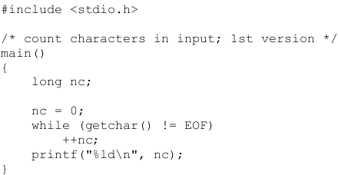
1.5.2 Character counting p18
New type: long
%ld

Slide 8
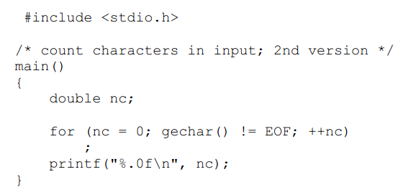
Version2: for statement p18
Rewrite with for statement
null statement

Slide 9
How to count?
Declare a variable to record
Initialize it to ZERO
Use a loop to count
Increase the variable
operator ++
Note: sometimes must test before count!!

Slide 10
1.5 Character Input and Output
1. File Copying
2. Character Counting
3. Line Counting
4. Word Counting

Slide 11
How to count lines？
Rewrite from “count characters”

Slide 12
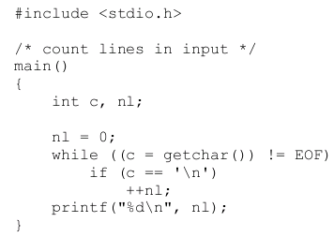
1.5.3 Line Counting p19

Slide 13
1.5 Character Input and Output
1. File Copying
2. Character Counting
3. Line Counting
4. Word Counting

Slide 14
How to count words?
rewrite from “count lines”

Slide 15
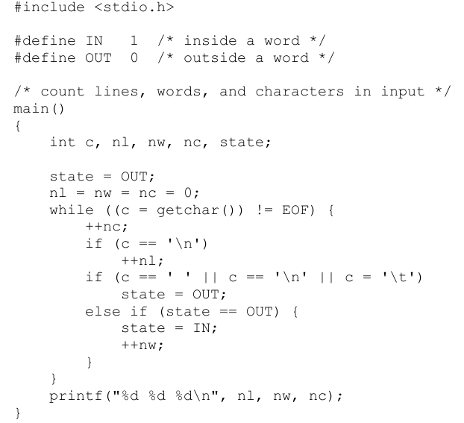
1.5.4 Word Counting p20

Slide 16
Summary for 1.5
1. File Copying
Ver1: c=getchar(); while(c!=EOF)
Ver2: while((c=getechar())!= EOF)
2. Character Counting
Ver1: while
Ver2: for
3. Line Counting
test before ++ if(c==‘\n’)
4. Word Counting
how to determinate “in/out a word”

Slide 17
Iteration statements
while statement
for statement
do statement

Slide 18
Loops: do-while p63

Slide 19
do statement & while statement
do
statement
while(expression);
statement;
while(expression)
statement

Slide 20
Loops: do-while
/* Calculates the number of digits in an integer */
#include <stdio.h>
int main()
{
int digits = 0, n;
printf("Enter a nonnegative integer: ");
scanf("%d", &n);
do {
n /= 10;
digits++;
} while (n > 0);
printf("The number has %d digit(s).\n", digits);
return 0;
}

Slide 21
Nested loops
int i,j;
i=1;
for(j=1; j<=5; j++)
printf("%d+%d=%d ", i, j, i+j);
putchar('\n');
int i,j;
for(i=1; i<=5; i++){
for(j=1; j<=i; j++)
printf("%d+%d=%d ", i, j, i+j);
putchar('\n');
}

Slide 22
Types of statements
Selection statements: if and switch.
Iteration statements: while, do, and for.
loops
Jump statements: break, continue, and goto.
return also belongs in this category.

Slide 23
Jump statements
break statement
jump out of a while, do, or for loop
continue statement
causes the next iteration to begin

Slide 24
break statement
Jump out of a while, do, or for loop
int n, d;
printf("Please a nonnegative integer:\n");
scanf("%d", &n);
for (d = 2; d < n; d++)
if (n % d == 0)
break;
if (d < n)
printf("%d is divisible by %d\n", n, d);
else
printf("%d is prime\n", n);

Slide 25
break statement
If nested loops, break only jumps out of the current loop
int n, d;
scanf("%d", &n);
for(d=2; d<n; d++){
while(n%d==0){
printf("%d*", d);
n /= d;
if(n==d)
break;
}
}
printf("%d", n);
Notes:
分解100

Slide 26
continue statement
causes the next iteration to begin
int n, sum, d;
sum = 0;
for(n=0; n<10; n++) {
scanf("%d", &d);
if (d%2 == 0)
continue;
sum += d;
}
printf("sum: %d\n", sum);

