Slide 1
Array and String
Lecture 9

Slide 2
Outline
One-dimensional array
digits counting
linear search & binary search
bubble sort
Tow-dimensional array
day of year
String: an array of characters

Slide 3
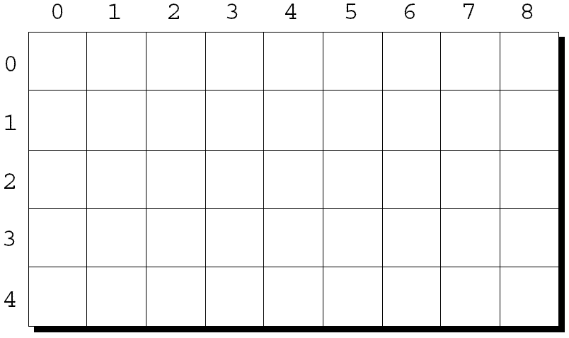
Two-Dimensional Array
An array may have any number of dimensions.
The following declaration creates a two-dimensional array:
int m[5][9];

Slide 4
Declaration & Initialization
√
int m[3][3];
int m[][3];
int m[3][];
int m[][3] = {{1,2,3},{4,5,6},{7,8,9}};
int m[3][] = {{1,2,3},{4,5,6},{7,8,9}};
int m[][3] = {{1,2},{4},{7,8,9}};
int m[3][3] = {0};
×
×
√
×
√
√

Slide 5
How to store
If m is an array of length 5x9

Slide 6
Array index
To access the element of m in row i, column j, we must write m[i][j].
The expression m[i] designates row i of m, and m[i][j] then selects element j in this row.

Slide 7
Array read from the console
int m[3][3];
int i,j;
for(i=0;i<3;i++)
for(j=0;j<3;j++)
scanf("%d",&m[i][j]);
for(i=0;i<3;i++){
for(j=0;j<3;j++)
printf("%d ",m[i][j]);
putchar('\n');
}

Slide 8
day of year, p111
int year, month, day;
int i, leap;
char daytab[2][13] = {
{0, 31, 28, 31, 30, 31, 30, 31, 31, 30, 31, 30, 31},
{0, 31, 29, 31, 30, 31, 30, 31, 31, 30, 31, 30, 31}
};
scanf("%d%d%d", &year, &month, &day);
leap = year%4 == 0 && year%100 != 0 || year%400 == 0;
for (i = 1; i < month; i++)
day += daytab[leap][i];
printf("%d\n", day);

Slide 9
Outline
One-dimensional array
digits counting
linear search & binary search
bubble sort
Tow-dimensional array
day of year
String: an array of characters

Slide 10
Character Arrays
Array of characters
Declaration
char s[100];
Initialization
char s[100] = {‘a’,’b’,’c’};

Slide 11
String
String : “hello\n”
Definition
Character Arrays Ending with ‘\0’
Stored in memory p30:

Slide 12
String
Declaration
char s[100];
Initialization
char s[100] = “abc”;
char s[100] = {‘a’,’b’,’c’,’\0’};
char s[100] = ‘abc’;
char s[3] = “abc”;
char s[ ] = “abc”;
√
√
×
×
√

Slide 13
Read & Write
scanf("%s", s); printf("%s", s);
gets(s); puts(s);
scanf("%s", s);
printf("%s", s);
gets(s);
printf("%s", s);
scanf("%s", s);
puts(s);
gets(s);
puts(s);

Slide 14
strlen p39
int main()
{
char s[100] = "1234567890";
int i=0;
while (s[i] != '\0')
++i;
printf("%d\n", i);
}

Slide 15
atoi p43
int main()
{
char s[100] = "354567";
int i, n;
puts(s);
n = 0;
for (i=0; s[i]>='0'&& s[i]<='9'; ++i)
n = 10 * n + (s[i]-'0');
printf("%d\n", n);
}

Slide 16
reverse p62
int main()
{
char s[100] = "abcdedfgh";
int c, i, j;
int n=0;
puts(s);
while (s[n] != '\0')
++n;
for (i=0, j=n-1; i<j; i++, j--) {
c = s[i];
s[i] = s[j];
s[j] = c;
}
puts(s);
}

